Slide 1
Convolutional Neural Nets
Tim Smith, PhD

Slide 2
Week05-Part1
Review DNN
Introducting batchnormalization and dropping layers
Introduce the concept of convolutional neural networks
Build an image recognition model using CNN

Slide 3
Normalizing and Dropping Layers
from keras.models import Sequential
from keras.layers import Dense, BatchNormalization, Dropout
# Create a Sequential model
model = Sequential()
# Add layers to the model
model.add(Dense(64, activation='relu', input_shape=(10,)))
model.add(BatchNormalization())
model.add(Dropout(0.5))
model.add(Dense(64, activation='relu'))
model.add(BatchNormalization())
model.add(Dropout(0.5))
model.add(Dense(1, activation='sigmoid'))
# Compile the model
model.compile(optimizer='adam', loss='binary_crossentropy’,
metrics=['accuracy'])
The dropout layers help prevent overfitting by randomly setting a fraction of input units to 0 during training, which introduces some level of regularization. The parameter 0.5 in Dropout(0.5) specifies the dropout rate, indicating that 50% of the input units will be dropped out during training.
By using batch normalization layers after each dense layer, we normalize the activations and reduce the internal covariate shift. This helps stabilize and speed up the training process.
You can modify the architecture, activation functions, dropout rates, and other parameters based on your specific needs.
Why?
Normalizing outputs from one layer before being sent to the next dense layer can speed up training and convergence on a solution.
Dropping can also speed up training, as a percentage of values are dropped before being processed by the next frame. With drop rates of 10%-15%, this can result in speeding up training while not having a significant negative impact on fitting.

Slide 4
Summary
We build, compile, fit and use Keras models
Building sets up the structure of the model
Compiling says something about loss function, and the optimizer being used Classification
Fitting involves batches of data being used to tune or ID parameter values of model.
Traits:
Binary Classifier
Final layer has one unit
Activation function for final layer is sigmoid
Loss function is binary_crossentropy
Multi-Class Classifier
Final layer has number of units equal to number of classes
Activation function for final layer is softmax
Loss function is categorical_crossentropy
NOTE: When using… Use argmax to determine which class is predicted
Regressor
Final layer has one unit
Activation function is none
Loss function is mean_squared_error

Slide 5
What is this?
tf.Keras.Sequential([
layers.Normalization(input_shape=[1,], axis=None),
layers.Dense(units=1)
])

Slide 6
Convolutional Neural Networks
"Discrete convolution": a mathematical operation on two functions (f and g) to produce a third function that expresses how the shape of one is modified by the other (Wikipedia)
Input data: images (usually)
Used in
Image search
Image classification
Self-driving cars

Slide 7
Review on Images
If black and white, there is 1 channel
If color, there are 3 channels: Red, Green, Blue (RGB)
B&W
RGB

Slide 8
Image Data
Image size is measured in pixels.
Ex: 480 x 480 means:
480
480
B&W
RGB
Size = 480 x 480 x 1
Size = 480 x 480 x 3

Slide 9
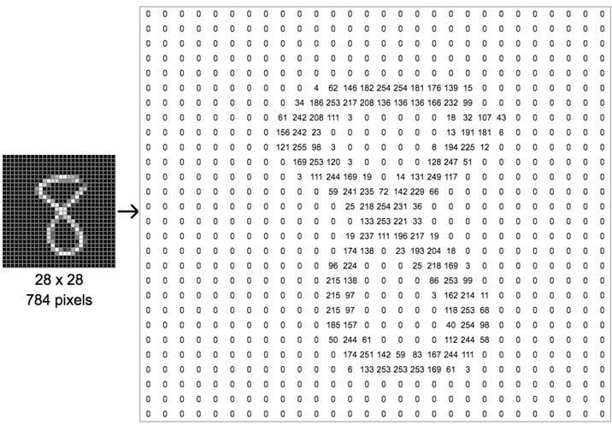
Image Data
Each pixel has a value between 0-255

Slide 10

Image Data
Let's think of a 1M (megapixel) image
1 megapixel = 1,000,000 pixels (1,000 x 1,000)
Resize
1,000
100
100
1,000
10,000 pixels
10K image

Slide 11
Image Data
Problem???
10 million connections in the first layer alone!
………………
100
100
Input layer = 10,000 nodes
Layer 1 =
1,000 nodes

Slide 12
Solution:
STEP 1 (convolution): Extract features from an image:
Horizontal lines,
Vertical lines,
Curvature,
Colors,
Etc.
STEP 2 (pooling): Reduce the variables (without losing information)
GET HELP FROM HUMAN VISUAL CORTEX

Slide 13
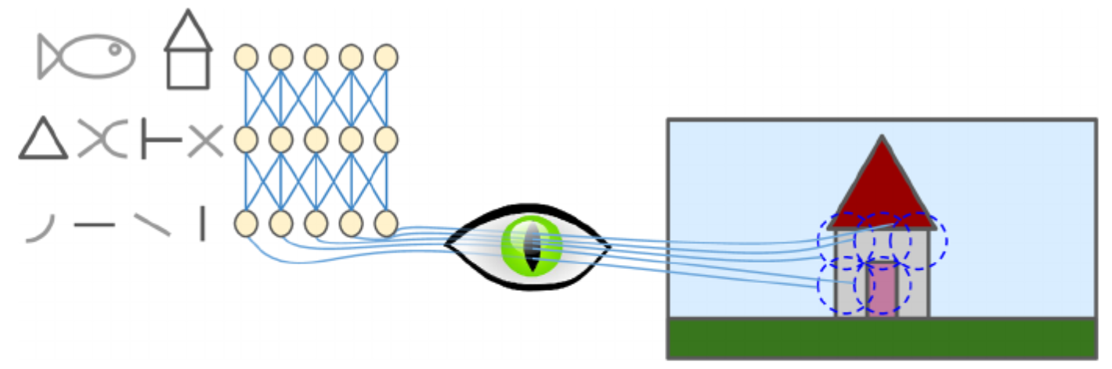
Convolutional Neural Networks
The visual cortex is made up of neurons
Each neuron has a specific receptive field (and do not necessarily see the things outside of that field)
Receptive field of a neuron

Slide 14
Convolutional Neural Networks
Further, some neurons react only to horizontal lines
Some react to different orientations
Higher level neurons make sense of the pattern detected at lower levels

Slide 15
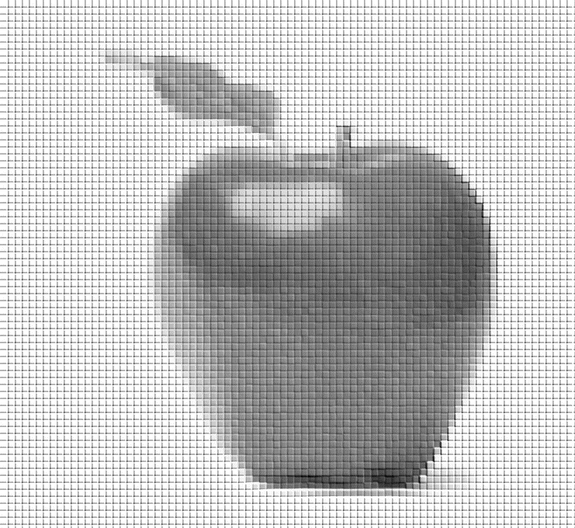
Convolutional Layer
Grayscale (1 channel)
Apply the same logic:
Feature Map 1
“Receptive field”
Also called:
“Filter”
“Kernel”
Extract vertical features using a vertical filter

Slide 16
Convolutional Layer
Grayscale (1 channel)
Apply the same logic:
Feature Map 2
“Receptive field”
Also called:
“Filter”
“Kernel”
Extract horizontal features using a horizontal filter

Slide 17
Convolutional Layer
Feature Map 1
Feature Map 2
Feature Map n
Conv Layer 1

Slide 18
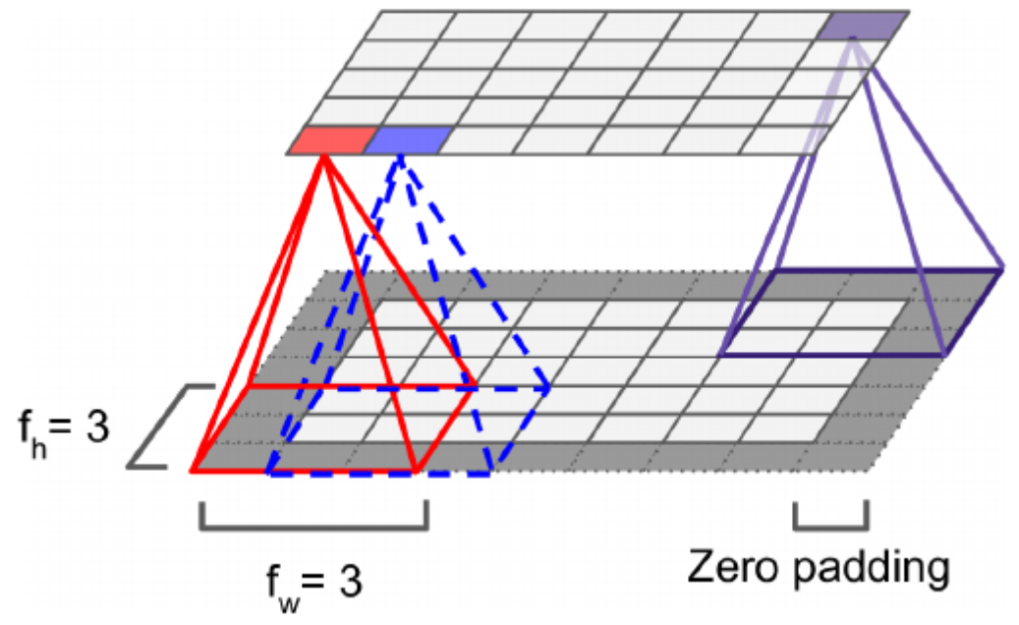
Convolutional Layer
Stride = 1
Makes the size of second layer the same as first

Slide 19
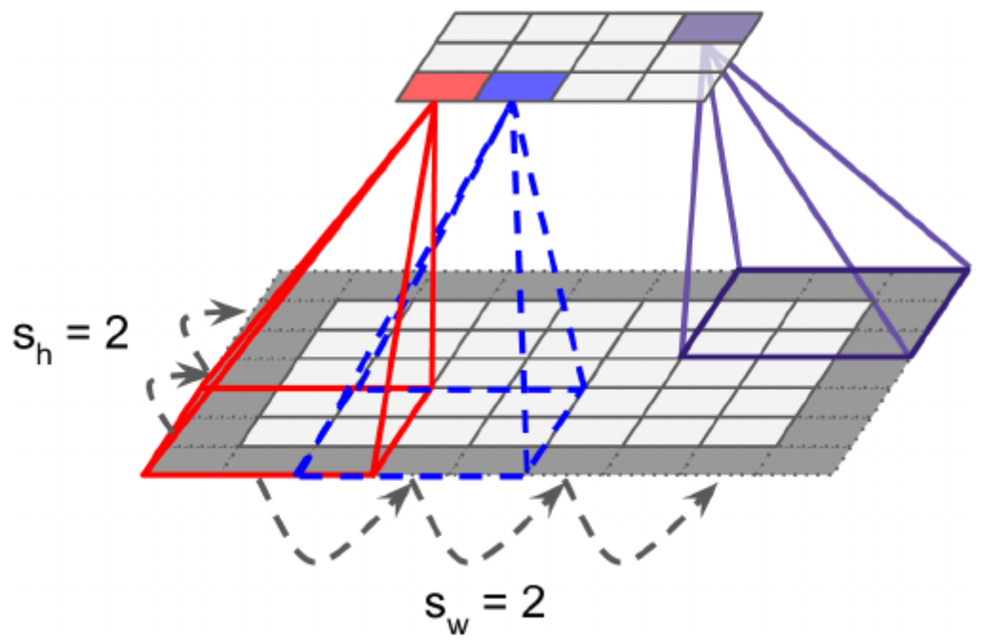
Convolutional Layer
You can have varying strides (both horizontally, and vertically)
Notice the size got smaller even with zero padding

Slide 20
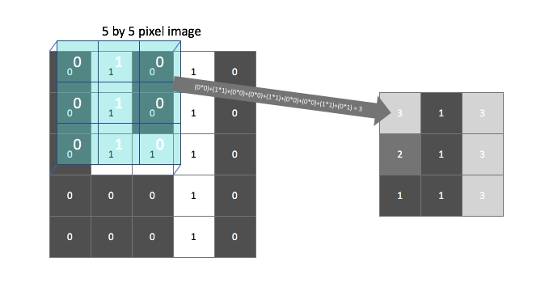
Convolutional Layer
How to process the values inside the “filter”
Multiply them with “weights” then add them up
Example: Apply “vertical” filter (to highlight vertical lines)
(Actually, this sum is passed through an activation function (ReLU) to introduce non-linearity
5 x 5 image
3 x 3 filter
0 | 1 | 0 | 1 | 0
0 | 1 | 0 | 1 | 0
0 | 1 | 1 | 1 | 0
0 | 0 | 0 | 1 | 0
0 | 0 | 0 | 1 | 0
0 | 1 | 0
0 | 1 | 0
0 | 1 | 0
Output is called “feature map”

Slide 21
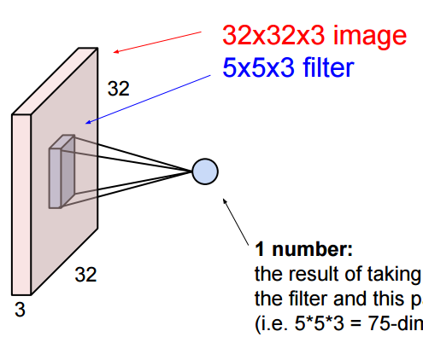
Convolutional Layer
If you have RGB (3-channel) image, the filter has 3 channels too

Slide 22
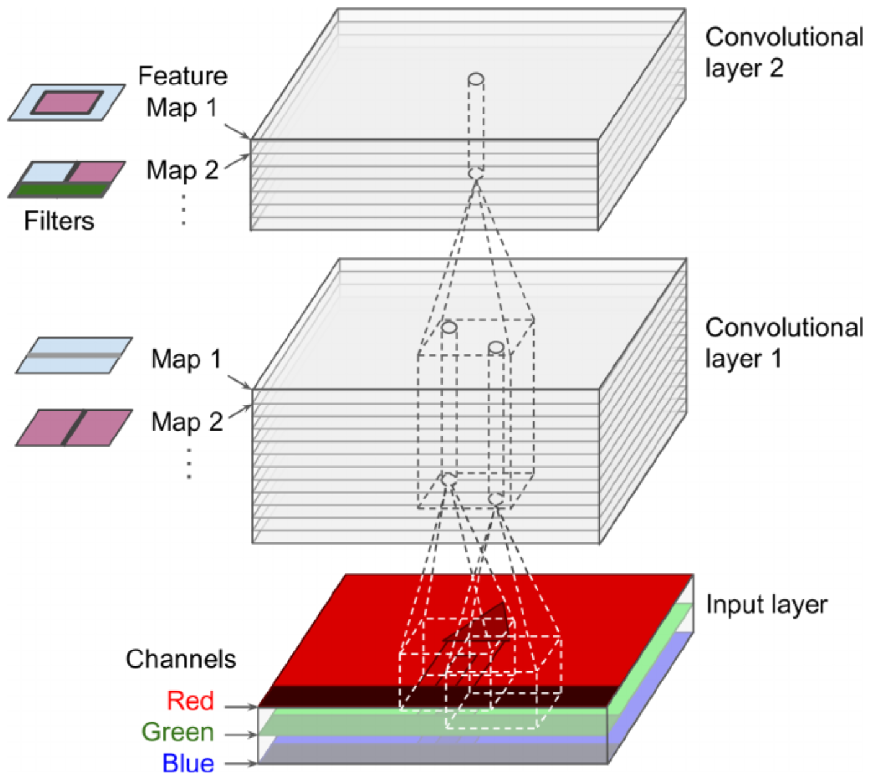
Convolutional Layer
Eventually, you have multiple feature maps (per convolutional layer)

Slide 23
Convolutional Layer
Then, apply “horizontal” filter (to highlight horizontal lines)
There are many more filters…
5 x 5 image
3 x 3 filter
0 | 1 | 0 | 1 | 0
0 | 1 | 0 | 1 | 0
0 | 1 | 1 | 1 | 0
0 | 0 | 0 | 1 | 0
0 | 0 | 0 | 1 | 0
0 | 0 | 0
1 | 1 | 1
0 | 0 | 0

Slide 24
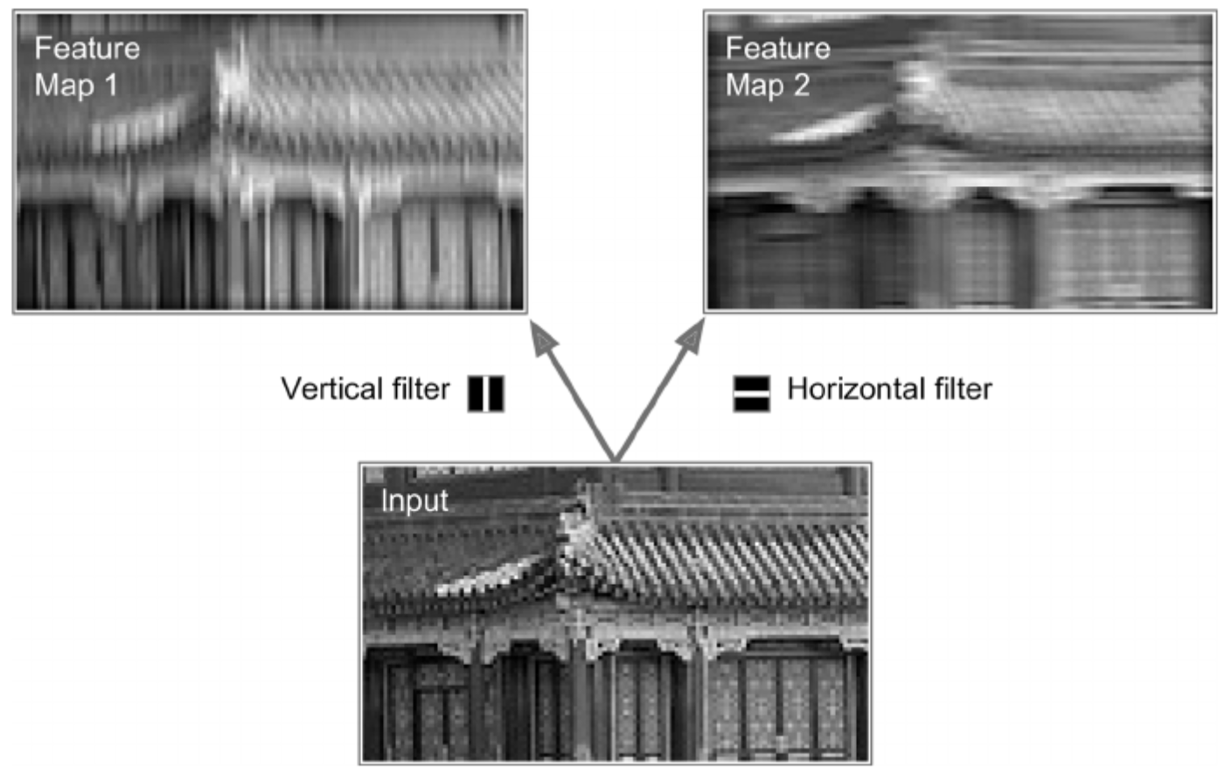
Convolutional Layer

Slide 25
Memory Requirements
Imagine a single image with 150 x 100 pixels
Filter of 5 x 5 with 1 stride
200 feature maps
Padding (add when necessary)
Calculations:
( 5 x 5 x 3 + 1 ) x 200 = 15,200 terms
Each feature map has 150 x 100 neurons that need to compute 5 x 5 x 3 inputs. Makes 225 million multiplications
1 image needs 12 MB RAM.
100 images 1.2 GB RAM.

Slide 26
Pooling Layer
“Shrinks” the convolutional layer (by sampling)
An “aggregation” technique!
Why:
Reduce computational load
Reduce number of parameters
Reduce overfitting

Slide 27
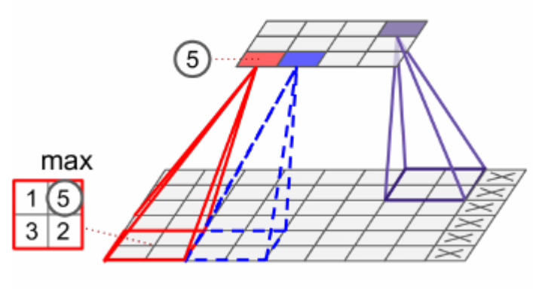
Pooling Layer
Similar to earlier: define the size, stride, padding type
It AGGREGATES the values
Example: use min, max, average, etc.
A 2 x 2 kernel with a stride of 2 reduces the image (inputs) by 75%
You can set it to shrink channels too

Slide 28
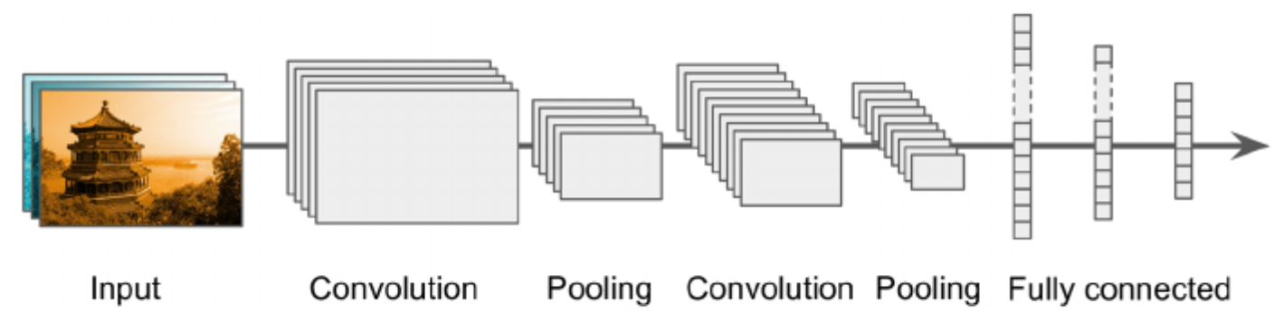
CNN Architectures
FLATTEN!!!
Based on “stacking”
Image gets smaller and smaller going through the layers
Use a regular deep neural network at the end
Regular neural network

Slide 29
CNN Architectures
Can also stack two convolutional layers one after another
Instead of having a 5 x 5 convo layer, have two 3 x 3 stacked convo layers. Might perform better!
Double the filter size as you go deeper in CNN
Regular neural network

Slide 30
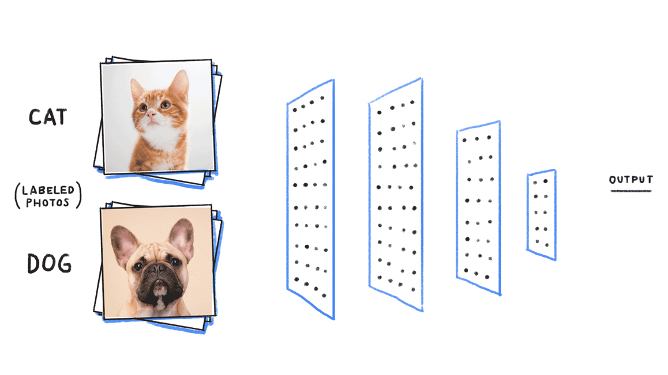
Data Requirements
We need labeled images (most of the time)

Slide 31
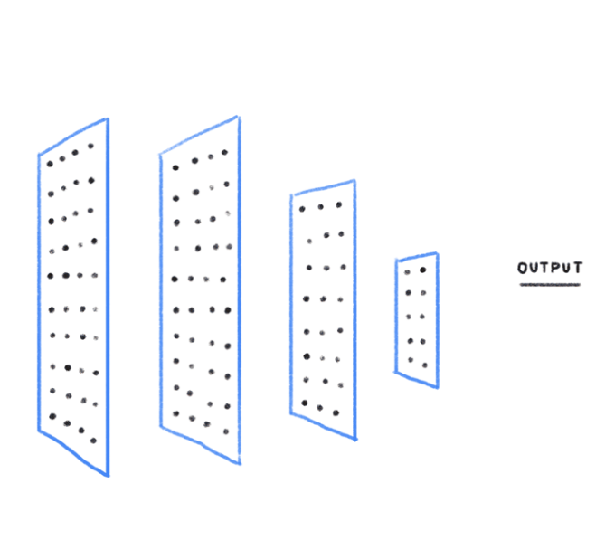

Image classification
New (unseen) image
CNN
Cat

Slide 32
Object detection
New (unseen) image
CNN
Cat 0.95

Slide 33
How Are We Going to Use CNNs?
Image classification

